Slide 1
Substrate Recovery Pallet
Easy. Simple. Secure.
Shawn Tabrizi Software developer @ Parity Technologies Ltd.
shawntabrizi@parity.io | @shawntabrizi

Slide 2
Let’s talk about multisigs.

Slide 3
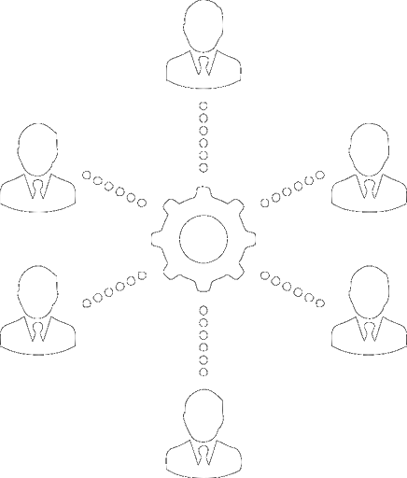
Multisignatures
Multisignature verification requires multiple keys to authenticate or authorize access to some underlying resource.

Slide 4
Multisignatures
Multisigs can be done both:
Cryptographically
Joint signature.
A generalization of both group and ring signatures.
Aggregation
Tracking individual signatures.
Can be done both off-chain and on-chain.

Slide 5

Substrate Multisignatures
Utility
Pallet
Collective
Pallet
SR25519
Aggregate Multisig + Governance Rules
-> Membership Origin
Cryptographic Multisig
Aggregate Multisig
-> Account

Slide 6
Back to the Recovery Pallet...

Slide 7

What is it?
The Substrate Recovery Pallet is an M-of-N social recovery tool.
It allows users to recover their accounts if the private key or other authentication mechanism is lost.

Slide 8
What is it?
The Substrate Recovery Pallet is an aggregate, on-chain multisignature where you can specify the set of users allowed to give access to your account.

Slide 9
How does it work?

Slide 10
Step 1: Create a Recovery Configuration

Slide 11

Select up to N friends you trust.

Slide 12

Choose a threshold M.

Slide 13
Pick a minimum delay period.
Initiate recovery process
 | Delay Period | Recoverable

Slide 14
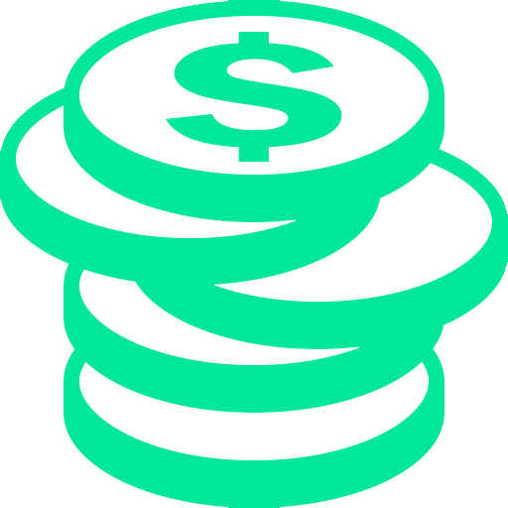
Place a refundable configuration deposit.

Slide 15

Step 2: Lose access to your account...?

Slide 16
Step 3: Initiate a Recovery Process

Slide 17

Create a new account.

Slide 18
Buy enough tokens to pay for the recovery deposit.

Slide 19
Initiate the recovery process.

Slide 20
Contact your friends to vouch for your recovery attempt.

Slide 21
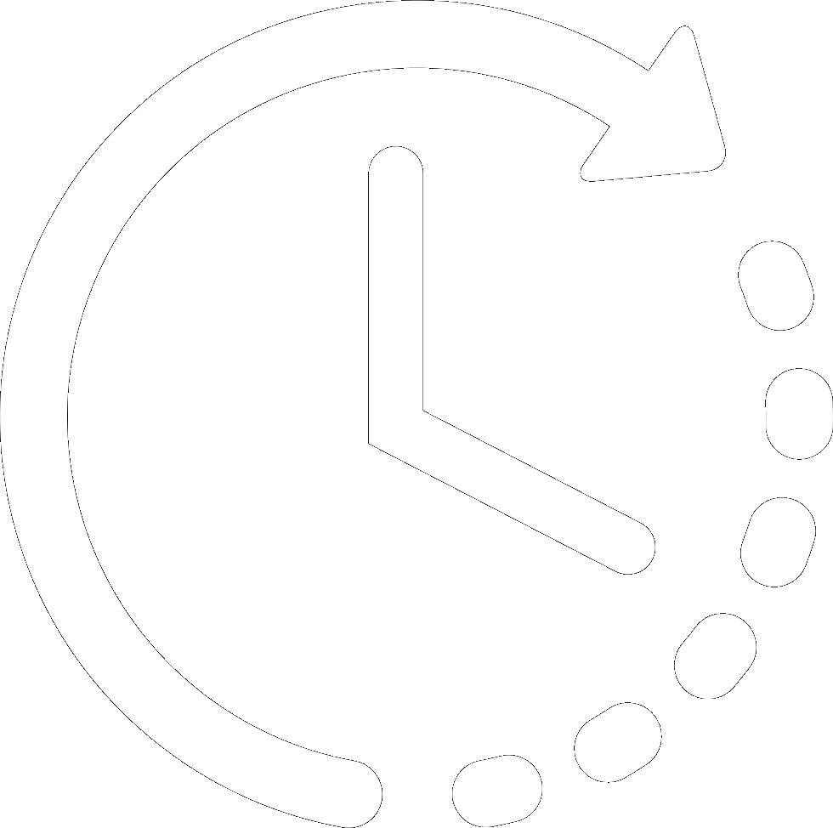
Wait for delay period to pass...

Slide 22
Claim your recovered account!

Slide 23

You can now make calls with your lost account!
Recovery
Pallet
Other
Pallets

Slide 24
Step 4: Clean up your old account

Slide 25
Close the recovery processes.
Recovery
Pallet

Slide 26
Remove your recovery configuration.
Recovery
Pallet

Slide 27
Unbond all staking positions.
Remove identity information.
etc...
Staking
Pallet
Recovery
Pallet
Identity
Pallet

Slide 28
Transfer all of your funds back.
Recovery
Pallet
Balances
Pallet

Slide 29
When your old account has no more funds, everything is cleaned up.

Slide 30
Malicious Recovery Attempts

Slide 31

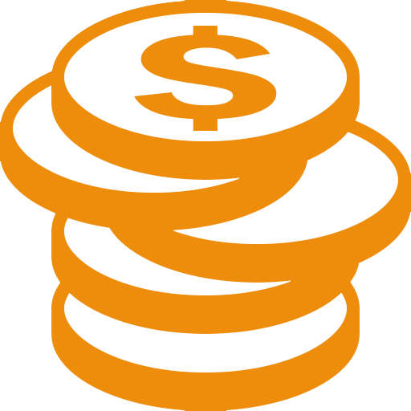
A malicious user initiates the recovery process.

Slide 32

They trick your friends to vouch for the recovery attempt.

Slide 33
They still need to wait for delay period to pass...

Slide 34
Still waiting...

Slide 35
At any point you are able to see this is happening!
!

Slide 36


Slide 37
Just close the recovery process...
$
Recovery
Pallet
Balances
Pallet

Slide 38

You can also update your “bad” friends.

Slide 39
So just check once every delay period.

Slide 40
Other Considerations

Slide 41
Configure an appropriate delay period...
The longer your delay period, the less often you will need to check the Recovery Pallet.
It is probably better to wait longer when you need to recover.

Slide 42
Specify a high threshold...
If you select a threshold of 1, any user in your friend list can recover your account.
2 means coordination between any two friends can...

Slide 43
Pick your friends wisely...
It is best to choose a diverse set of friends.
Helps avoid coordination.
You should update them regularly as life changes.

Slide 44
Other ideas...
Keep your friends list secret.
Keep the recovery process secret.
Offline notification system for recovery attempts.

Slide 45

Parity Banana Split
https://bs.parity.io/
Shamir Secret Sharing
Generate N QR codes which you can print out.
Share them with trusted friends and family.
You need N/2+1 QR codes to reconstruct your key.
Plus an additional passphrase.

Slide 46
Questions?
shawntabrizi@parity.io @shawntabrizi

Slide 47

Setup
Any user can create a recovery configuration.
Select up to N friends you trust.
Choose a threshold M of those friends needed to recover.
Pick a minimum delay period in blocks required to pass from the beginning of the recovery process to recover.
Place a refundable deposit as long as you have the config.

Slide 48
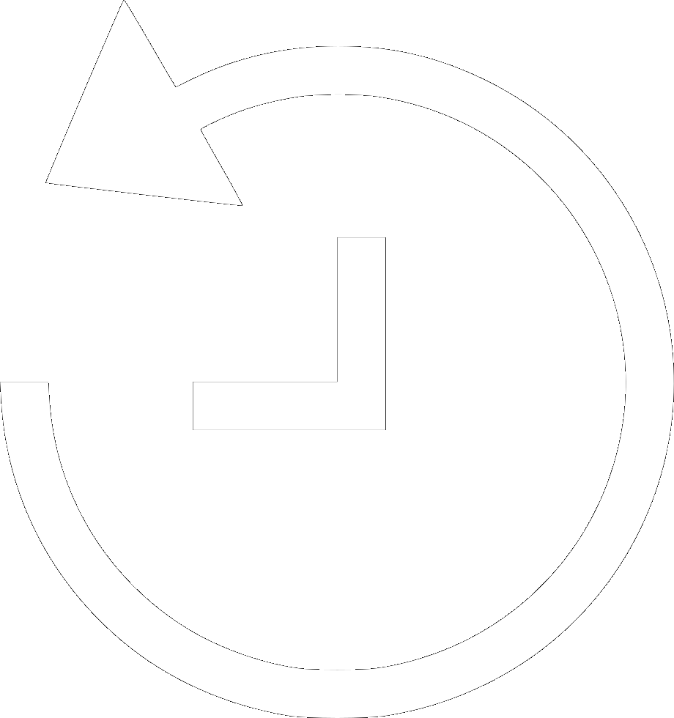
Recovering Your Account
Create a new account.
Buy enough tokens to pay for the recovery deposit.
Initiate the recovery process.
Contact your friends off-chain to vouch for your recovery.
You need M of N approvals based on the threshold you set.
Wait until the delay period has passed.
Claim your recovered account!

